Slide 1

AI LEANRNING LANGAUAGE APP
The Effeciant way to learn English
(LINGOOSE)
BY:
Mark Maher
Kerolos Rafat
Boules Ashraf
Engy Emad
Afraym Herz
Ahmed Mansour
Kerolos Said
Merona Romany
Supervision of
Dr. Eman Hossny
Eng. Hams Khaled

Slide 2
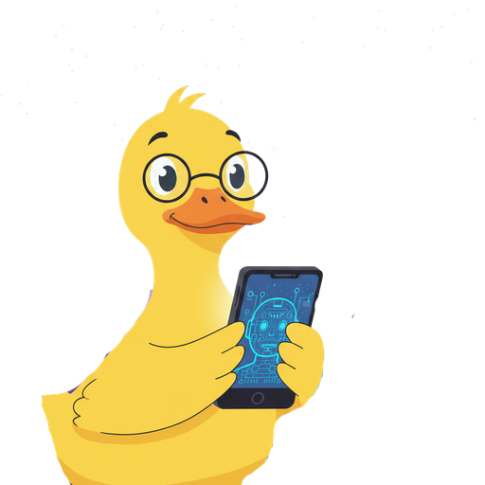
Agenda:
01
Intorduction
06
System design & architecture
02
Motivation
07
Main Features
03
08
Problem Statement
Dataset & AI models
04
Related Work
08
Conclusion
05
Objectives
09
Future work

Slide 3
Abstract
Mobile App for learning
Speak and practice with ai
Learn with reels style
Divide the learning by levels
Memorize the learn process
In the future can add more languages
Error detection and correct

Slide 4
Introduction
Growing demand for technology-enhanced learning
E-learning: popular & effective learning method
Flexible and accessible for all learners
Learn anytime, anywhere via smartphones & tablets
Self-learning: one of the most effective learning approaches

Slide 5
Motivation
Market Opportunity:
High Demand: Global interest in learning for travel and work
Digital Shift: E-learning is now essential and booming
Current Gaps:
The Churn Problem: High initial downloads, but severe user drop-off over time
Tech Gap:Traditional apps don't use modern AI
Rigid Experience: Existing solutions are not customizable and for user levels
Lack of Engagement: Current apps miss social and motivational features

Slide 6
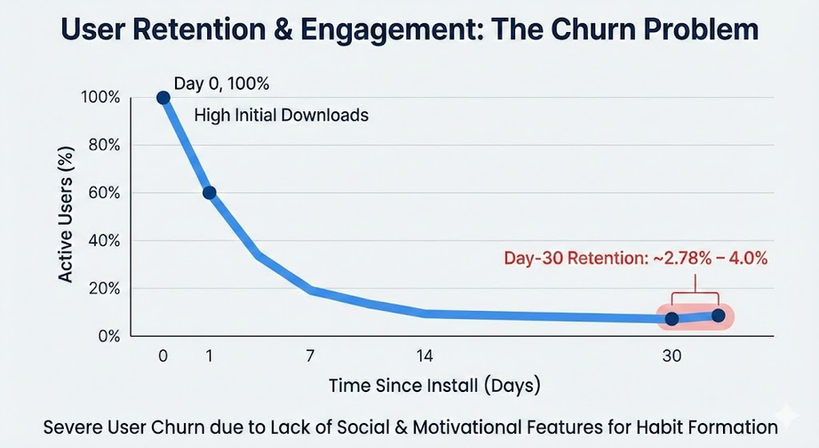
Problem Statement
1) User Retention & Engagement
High initial downloads but severe user churn
Day-30 retention only ~2.78%–4.0%
Lack of social
2) Learning Effectiveness (Efficacy)
Some apps are non-adaptive and don’t personalize support
Leads to limited improvement in core language skills
3) Lack of social interaction in the self-learning experience

Slide 7
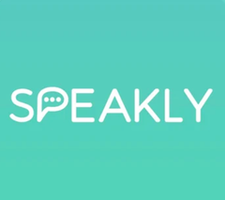


Related Work
2024
2023
2024
 | Speak – AI | Stimuler AI | Lerna
Ease of use | Medium | Hard | Hard
Gemification | High | No Gemification | No Gemification
Price | High | 12$ per year Cheapest one | Medium
Content | fully generated with ai | poor content | Unstructured
Socialization | no socialization | no socialization | no socialization
Applications
Features

Slide 8

Objectives
Develop an adaptive AI-powered mobile app to improve English proficiency.
Leverage AI customizatiom, speech recognition, microlearning, and spaced repetition
Implement gamification and social interaction

Slide 9
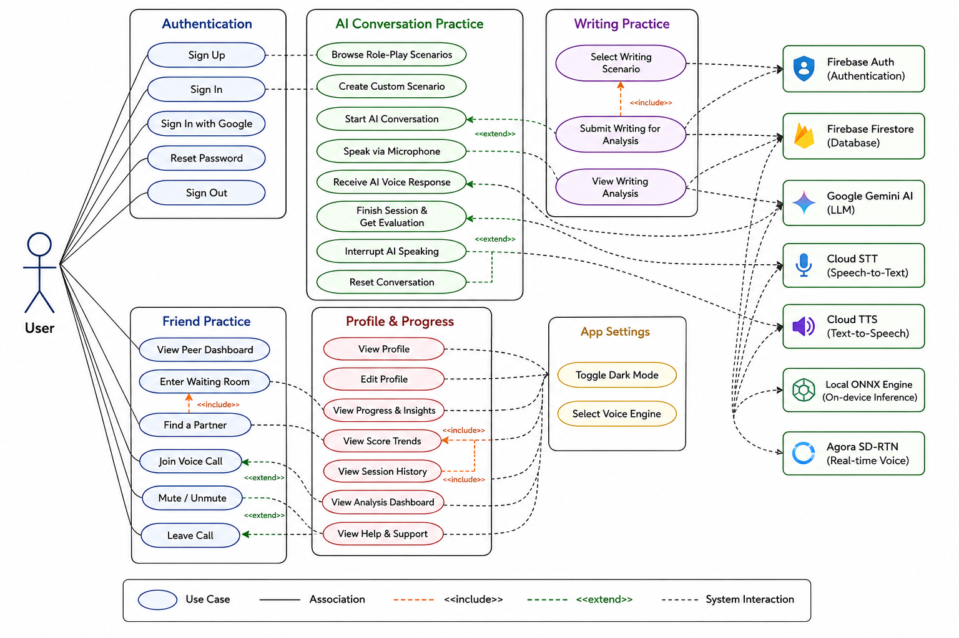
Use Case Diagram

Slide 10
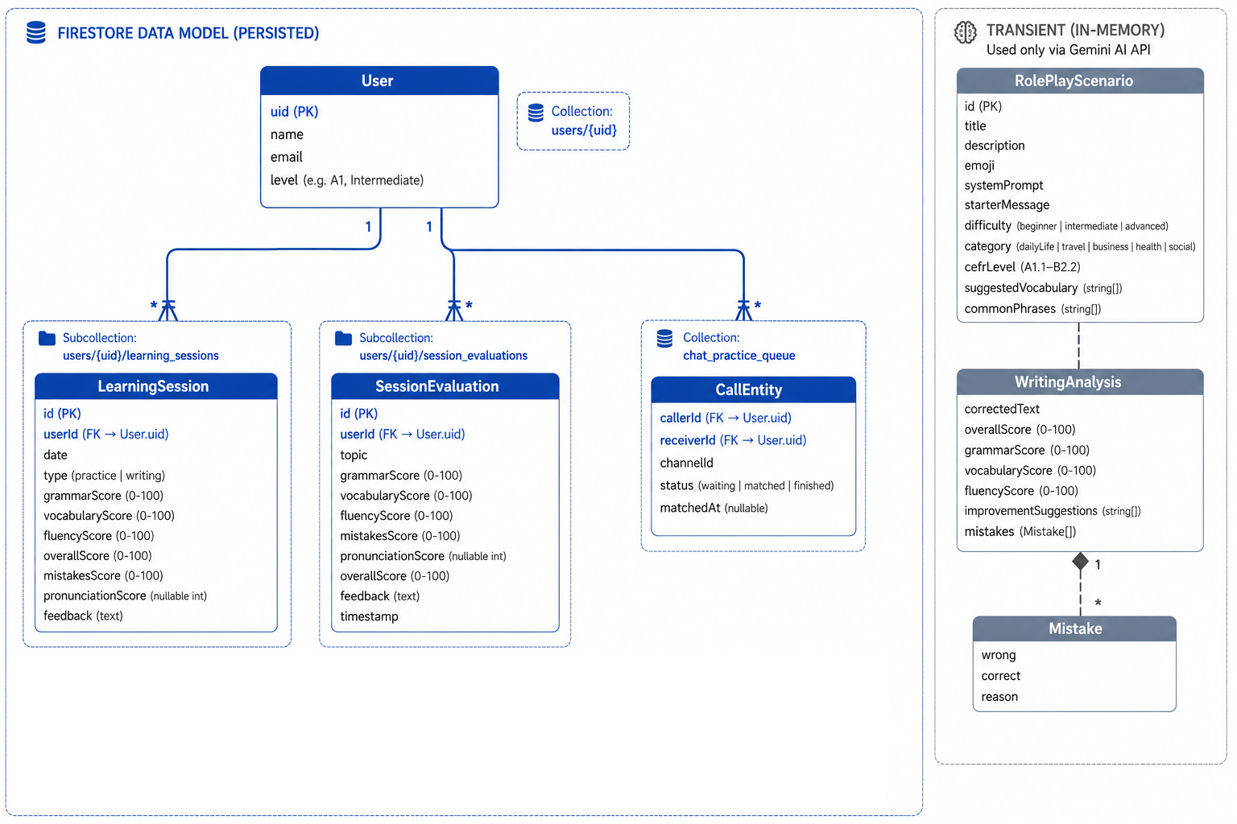
ERD DIAGRAM

Slide 11
Lingoose functionality
Main Features

Slide 12
Lingoose functionality
Practice with AI
AI Writing Practice
Practice with friends
Detailed Level Analysis
Roleplay Senarios

Slide 13
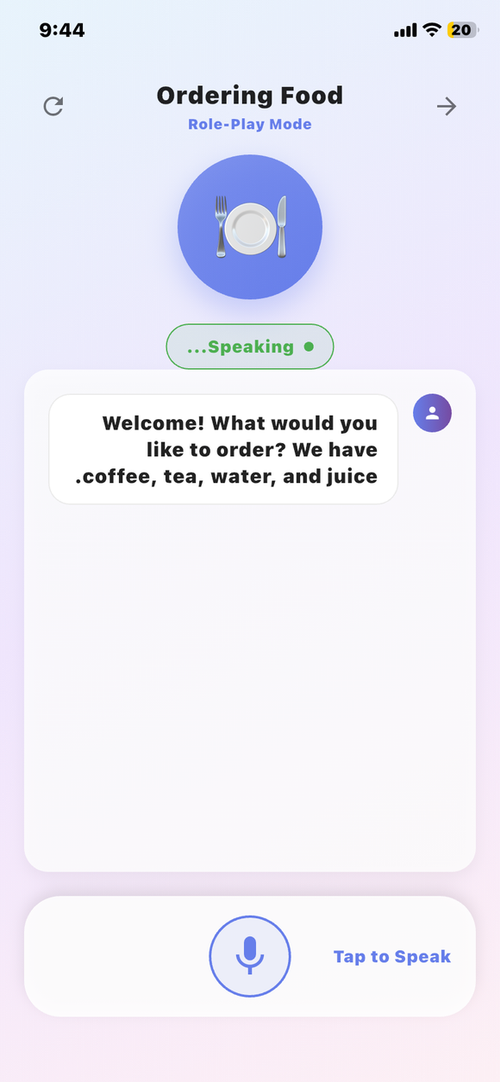
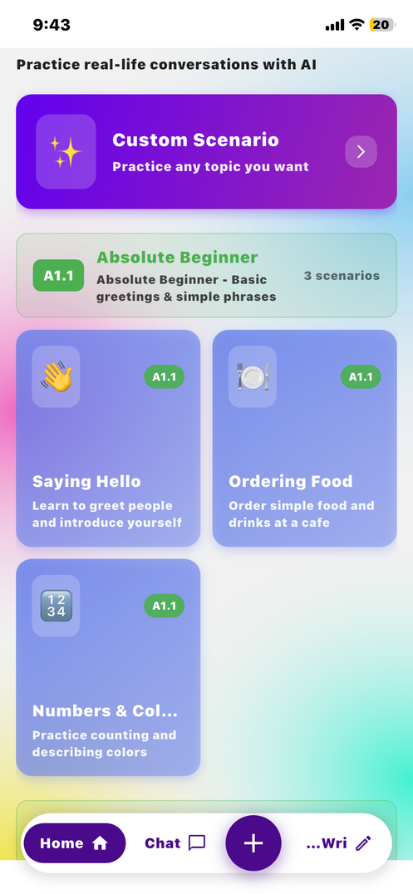
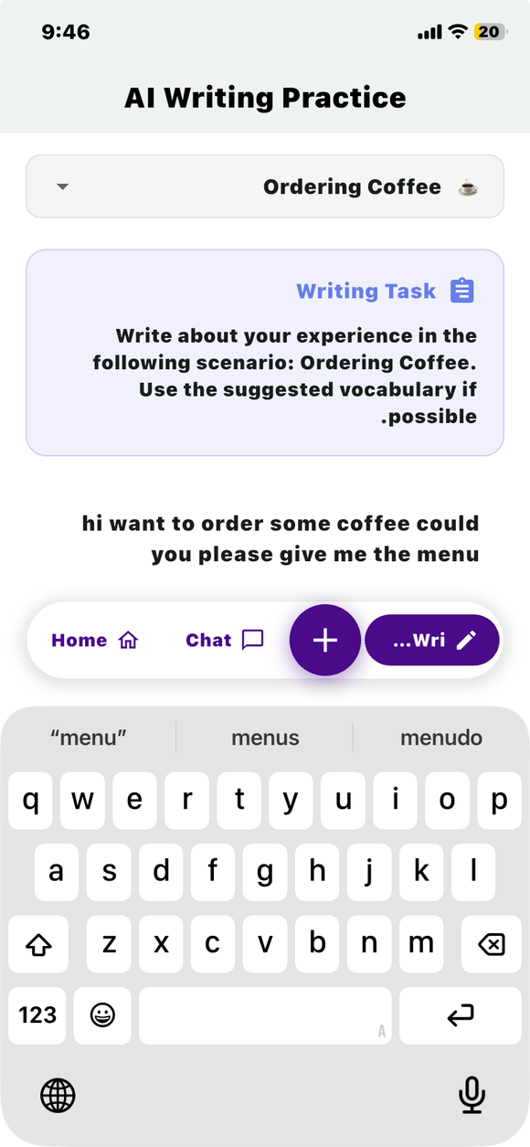
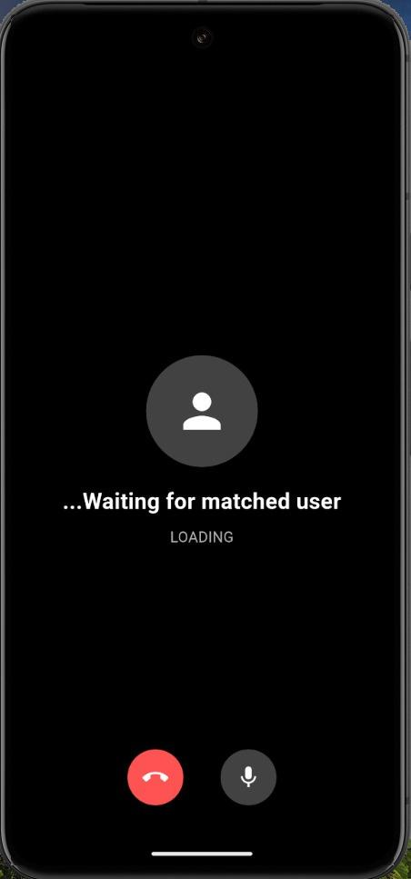
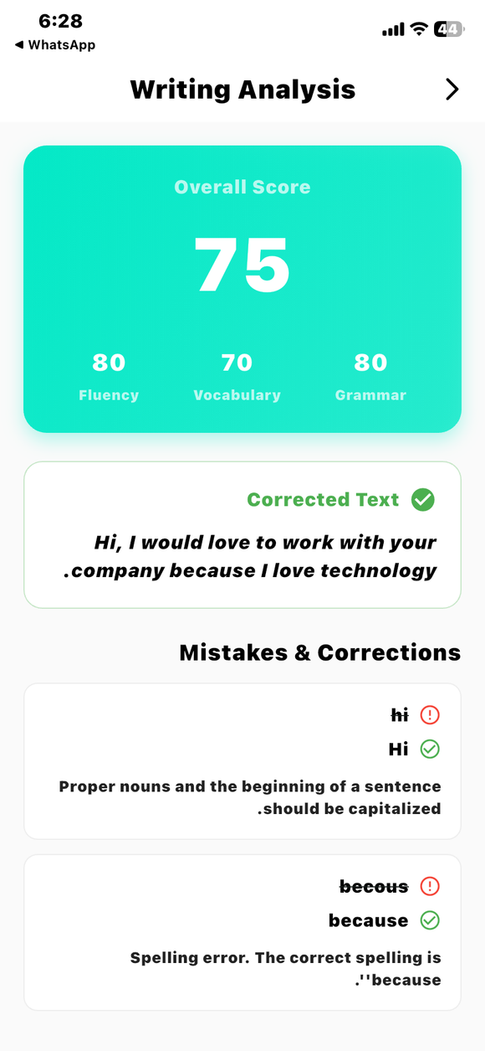
Practice with AI
Practice with
Friends
Detailed Report
Home
AI Writing
Practice

Slide 14



Technologies :
1) Mobile App Development
Flutter (cross-platform mobile framework)
Dart (programming language)
2) Backend / Database
Firebase platform services
Cloud Firestore (database for users, progress, content, social feed, etc.)

Slide 15
Dataset & AI models

Slide 16
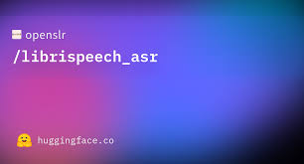
Dataset
LJSpeech
Utilized the LJSpeech benchmark dataset
Sourced from LibriVox public domain audiobooks
Contains 13,100 high-quality, normalized audio clips
Total volume: 2.6 GB (~24 hours of audio)

Slide 17
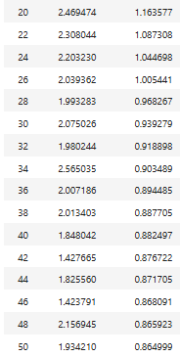
STT Model Architecture
Integrated a fine-tuned Whisper model for Speech-to-Text.
Optimized and trained on the LJSpeech benchmark dataset
Processes log-mel spectrogram inputs via advanced Transformer encoder-decoder blocks
Transforms speech into precise text outputs instantly with high accuracy

Slide 18
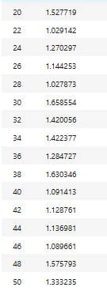
TTS Model Fine Tune
Fine-tuned FastSpeech2 and HiFi-GAN on the LJSpeech benchmark dataset
Achieved highly stable training with a Loss = 0.354
Optimized validation Accuracy to 96.5%
Generates exceptionally smooth, high-quality waveform audio

Slide 19
Prompt Engineering Layer
Generic Prompting Layer
Role-Play Scenario Prompt
User Input:
"Explain the difference between 'since' and 'for'."
Generated Prompt:
"Act as an English tutor. Explain the difference between 'since' and 'for' using simple language, provide 3 examples for each, and end with a short practice exercise."
Output:
Clear explanation, examples, and practice questions.
Scenario: Ordering food at a restaurant.
Generated Prompt:
"Act as a restaurant waiter. Conduct a realistic conversation with the learner, encourage them to place an order, ask follow-up questions, and provide corrections only after the conversation ends."
Output:
Interactive dialogue that simulates a real-world conversation.

Slide 20

Demo
https://drive.google.com/file/d/1TxLYk-HjUFfssOOs1HusutFENn42E6uc/view?usp=drive_link

Slide 21
Future work
Increase the app's gamification features to improve user retention.
Reduce voice mode latency.
Support preparation for language proficiency tests such as IELTS.

Slide 22
Conclusion
“Learning is most powerful when it adapts to the learner, not when the learner is forced to adapt to the system”
In conclusion, this project presents an AI-driven application that employs adaptive learning algorithms to analyze user performance, determine proficiency levels, and continuously personalize the learning flow to optimize learning outcomes.

Slide 23
Thank you.

